Slide 1
Retrieval-Augmented Medical Question Answering Assistant Submitted by: K.Navya-240030180 N Deepika – 2420030097 K.Bhavya-2420030181 Group Number: 1 Section: 7 cluster: 3
Under the Guidance of: Mrs.Swanthana

Slide 2
Contents
Abstract
Problem statement
objectives
Literature survey
Research Gap Identification
Innovation
Creativity
Novelty
Feasibility
Flowchart
Project Plan

Slide 3
Abstract
Many users receive inaccurate or misleading medical information from search engines and general AI chatbots.
This project develops an RAG based Medical Question Answering Assistant that provides reliable and context-aware medical answers.
The system uses the MedQuAD dataset as a trusted medical knowledge base.
BioBERT is used for understanding medical text, FAISS for retrieving relevant information, and LangChain with an LLM for generating accurate responses.
The application is built using Python, Flask, HTML, CSS, and JavaScript with a simple and user-friendly interface.
Additional features include user login, search history, download, and medical disclaimers.
The proposed system aims to reduce incorrect AI responses by retrieving information from trusted medical sources before generating answers.

Slide 4
Problem Statement
Nowadays, many people search online for medical information. However, search engines and general AI chatbots may provide incorrect, incomplete, or unreliable answers. In healthcare, such misinformation can lead to poor decisions. Most existing systems do not retrieve information from trusted medical sources before generating responses.
This project aims to solve this problem by developing a RAG-based (Retrieval-Augmented Generation) Medical Question Answering Assistant that retrieves relevant information from trusted medical datasets before generating accurate, reliable, and source-supported medical answers.

Slide 5
Objectives
The main objectives of this project are:
To Develop a web-based Medical Question Answering Assistant for reliable medical information retrieval.
To Integrate the MedQuAD dataset as the primary medical knowledge base for the system.
To Implement BioBERT embeddings to capture the semantic meaning of medical queries and documents.
To Construct a FAISS vector database for efficient semantic similarity-based retrieval.
To Orchestrate the RAG pipeline using LangChain to combine retrieved medical context with user queries.
To Generate context-aware medical responses using a Large Language Model (LLM).
To Minimize unsupported or hallucinated responses by grounding generated answers in retrieved medical information.
To Design an interactive web interface with authentication, search history, suggested questions, and responsive UI features

Slide 6
Literacy survey
Research Paper | Techniques Used | Purpose | Limitation
BioBERT: A Pre-trained Biomedical Language Representation Model (2019) | BioBERT, NLP | Understands biomedical text and improves medical NLP tasks. | Does not retrieve medical documents or use RAG.
Pre-trained Language Model for Biomedical Question Answering (2019) | BioBERT, Fine-tuning | Answers biomedical questions using the BioASQ dataset. | No semantic retrieval or source citations.
Towards Physician-Level Medical Question Answering with LLMs (Med-PaLM, 2023) | Large Language Model (LLM) | Generates medical answers with high accuracy. | Proprietary and requires high computational resources.
Improving Retrieval-Augmented Generation in Medicine (i-MedRAG, 2024) | RAG, LLM | Improves medical question answering using retrieval. | Complex architecture and higher processing time.
Efficient Biomedical Question Answering using RAG (2025) | RAG, FAISS, BioBERT | Retrieves relevant medical information before answering. | Research-focused; not a complete web application.

Slide 7
Research Gap Identification
From the literature survey, the following research gaps were identified:
Existing systems may generate incorrect or unsupported medical responses.
Many models do not retrieve information from trusted medical datasets before answering.
Most systems do not provide source references for generated answers.
Several solutions are research-focused and not suitable for everyday users.
.
Innovation
The proposed system introduces:
Retrieval-Augmented Generation (RAG) for reliable medical question answering.
BioBERT embeddings for better understanding of medical terminology.
FAISS vector search for fast semantic retrieval.
Source-supported responses using trusted medical datasets.
An interactive web application with login, search history, and modern UI.

Slide 8
Creativity
The project combines modern AI technologies with a user-friendly healthcare platform.
Key creative features include:
AI-assisted medical question answering.
Glassmorphism-based responsive interface.
Suggested medical questions.
Search history.
Source citations.
Medical disclaimer.
Emergency warning for critical symptoms.
Dark/Light mode support.

Slide 9
Novelty
The uniqueness of this project lies in integrating:
BioBERT for biomedical language understanding.
FAISS for semantic document retrieval.
LangChain for RAG workflow management.
Large Language Models for response generation.
Trusted medical datasets with source citations.
A complete web-based medical assistant instead of a standalone research model.
This combination improves answer accuracy, transparency, and user trust.

Slide 10
Feasibility
The project is feasible because:
Technical Feasibility
Uses open-source technologies such as Python, Flask, LangChain, BioBERT, and FAISS.
MedQuAD dataset is publicly available.
Can be developed using standard software tools.
Economic Feasibility
No expensive software or hardware is required.
Uses freely available datasets and libraries.
Operational Feasibility
Easy to use through a simple web interface.
Suitable for students and general users.
Can run on a normal laptop.

Slide 11
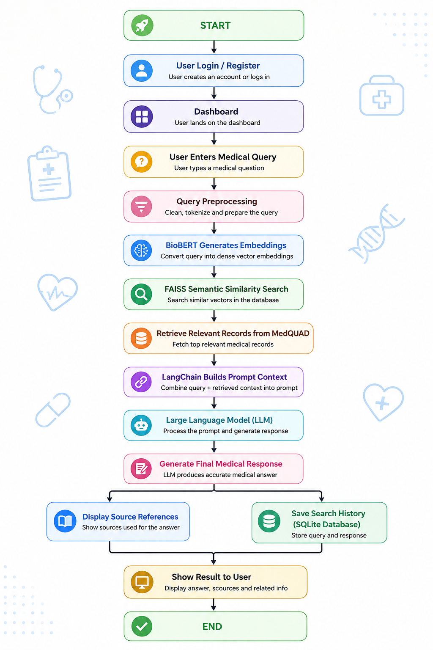
Approach
Flow Chart

Slide 12
Project plan
 | Activity | Description
Phase 1 | Requirement Analysis | Identify the project objectives, scope, and user requirements.
Phase 2 | Literature Survey | Study existing medical question answering systems and related research papers.
Phase 3 | Dataset Collection | Collect and understand the MedQuAD dataset for building the knowledge base.
Phase 4 | Data Preprocessing | Clean, organize, and prepare the dataset for embedding generation.
Phase 5 | BioBERT Embedding Generation | Convert medical text into semantic vector embeddings using BioBERT.
Phase 6 | FAISS Vector Database Creation | Store embeddings in FAISS to enable fast semantic similarity search.
Phase 7 | RAG Pipeline Development | Integrate LangChain and the Large Language Model (LLM) to build the Retrieval-Augmented Generation pipeline.
Phase 8 | Frontend Development | Design and develop a responsive user interface using HTML, CSS, and JavaScript.
Phase 9 | Backend Development | Develop the backend using Python Flask, manage user authentication, and connect all modules.
Phase 10 | Integration & Testing | Integrate the frontend, backend, database, and AI components; perform testing and fix issues.
Phase 11 | Documentation & Deployment | Prepare the project report, presentation, user documentation, and deploy the application.

Slide 13
Thankyou

